Slide 1
INFO 341 Data Centers, NOCs & Clouds Overview
By
Bob Larson

Slide 2
Topics Covered
What is a Data Center?
In-house Data Services
Outsourced Data Services
Green Data Centers – Power Issues
Virtualization
Network Operation Center (NOC)
Business Operations Center
Remote Monitoring

Slide 3
What is a Data Center?
Sometimes spelled datacenter
A centralized repository
Either physical or virtual
For the storage, management, and dissemination of data and information
Organized around a particular body of knowledge or pertaining to a particular business

Slide 4
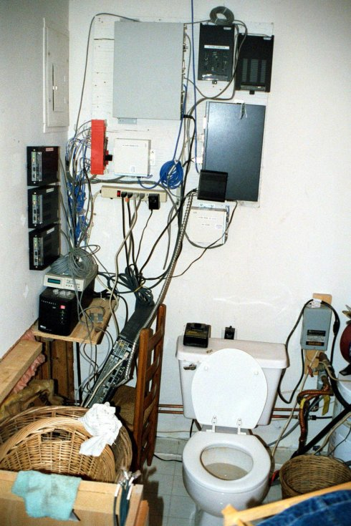
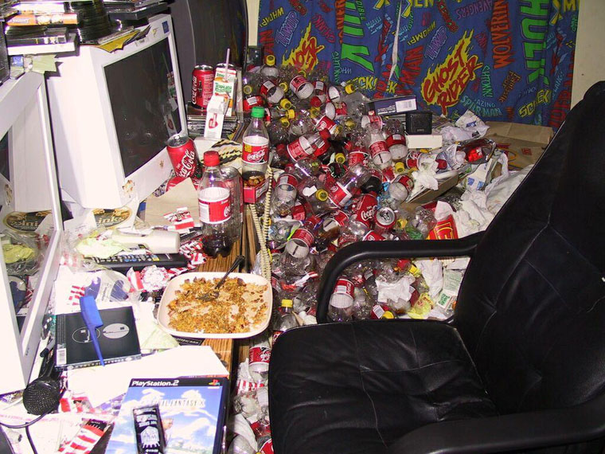

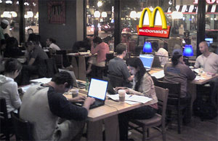
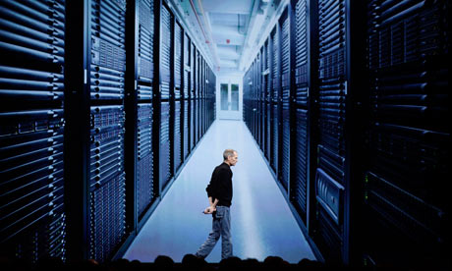
In-house Data Services

Slide 5
Outsourced Data Services
Outsourcing Staffing of Data Center
All or just key positions
Colocation services
Renting local rack space
Provides space, power, cooling, security
Cloud Computing
Deployment Models
Service Models

Slide 6
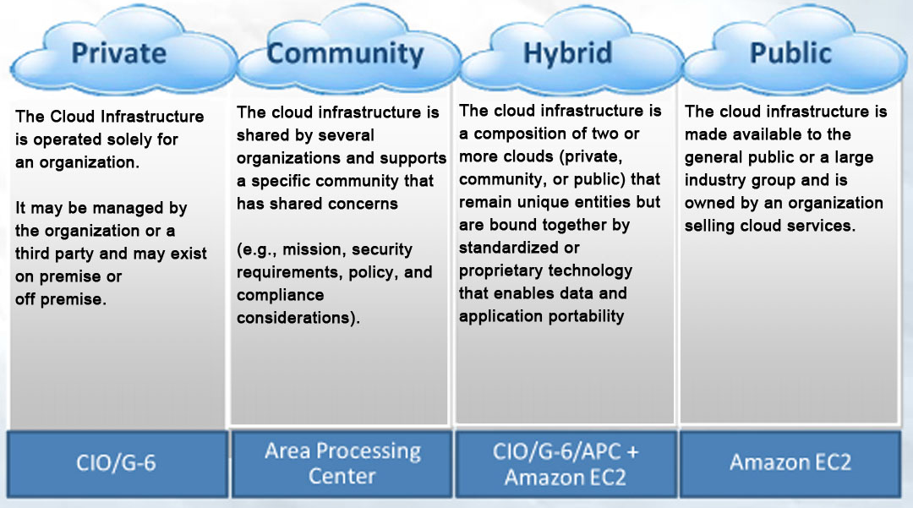
Cloud Deployment Models

Slide 7
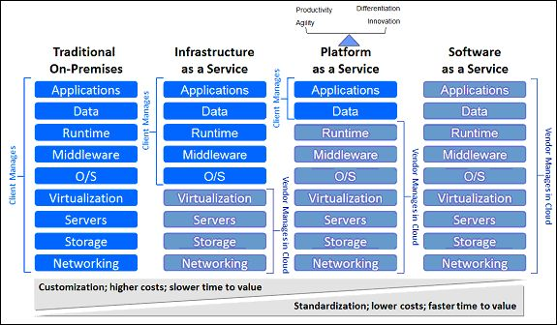
Cloud Service Models
IaaS
PaaS
SaaS
Other variations – reflect services included or marketing gibberish

Slide 8
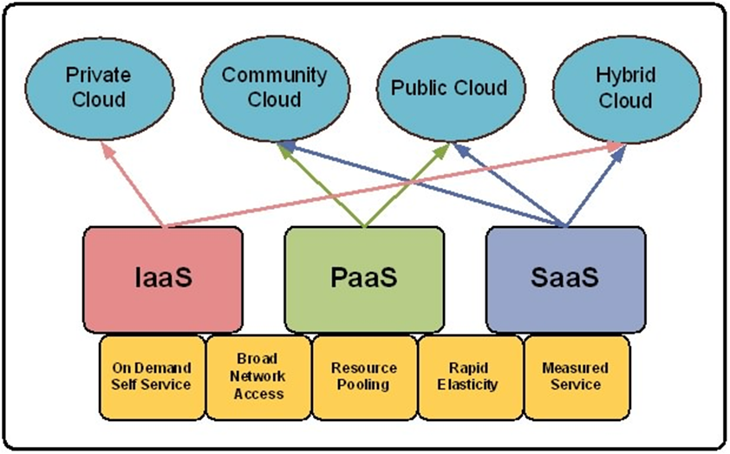
How They Fit Together

Slide 9
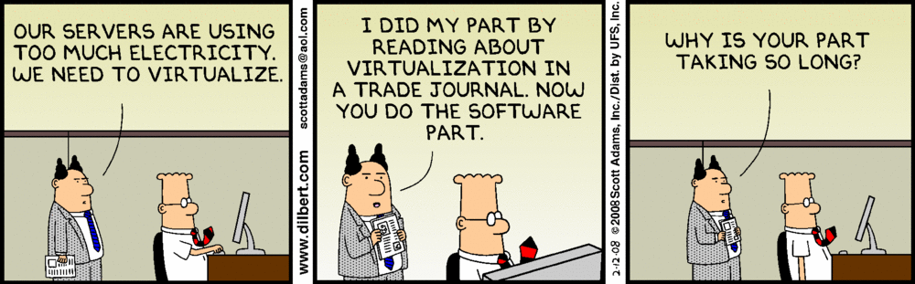
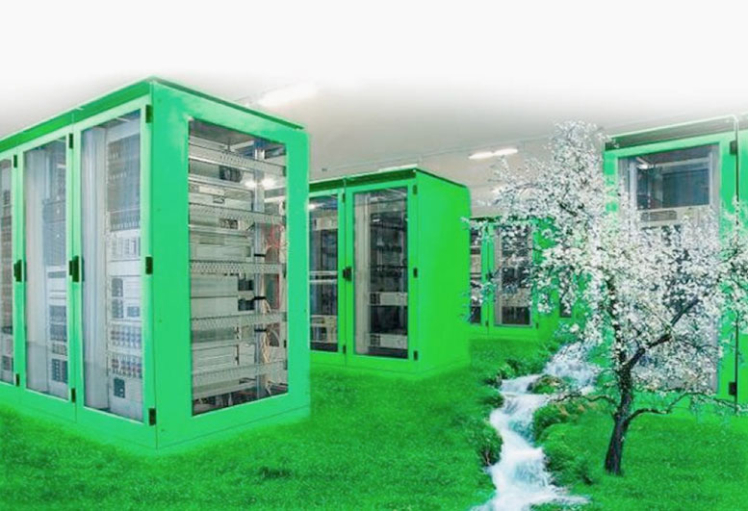
Green Data Centers

Slide 10
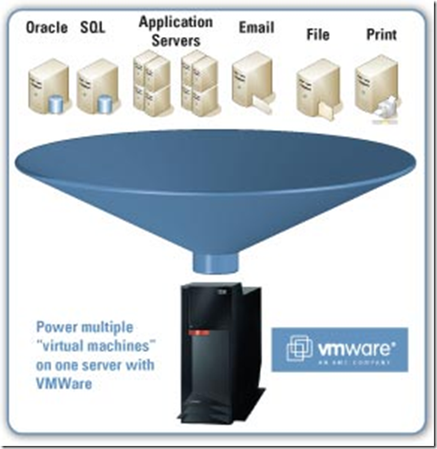
Virtualization
Implementations
Servers
Desktops
Routers
Firewalls
Benefits
Fewer devices
Less space
Less hardware
Less power
Less cooling

Slide 11
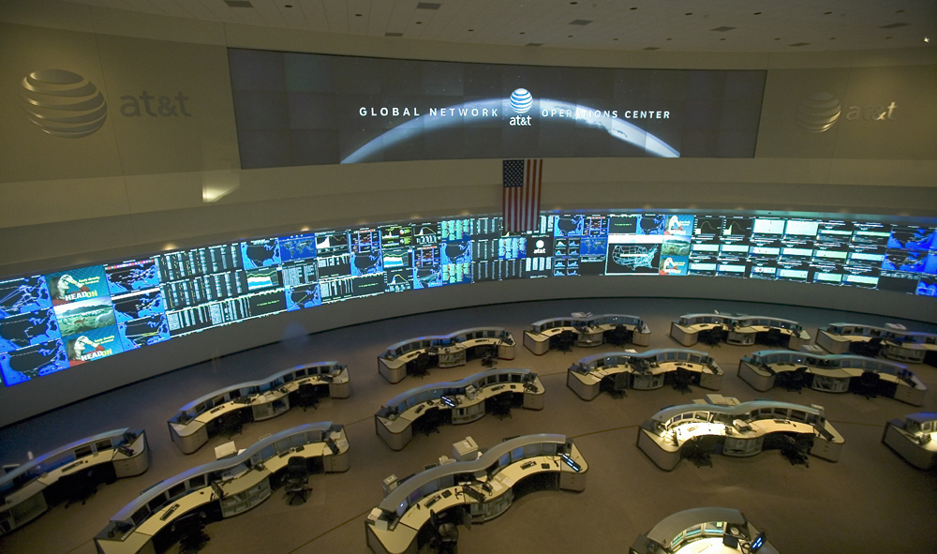
Network Operation Center (NOC)

Slide 12

Business Operations Center

Slide 13
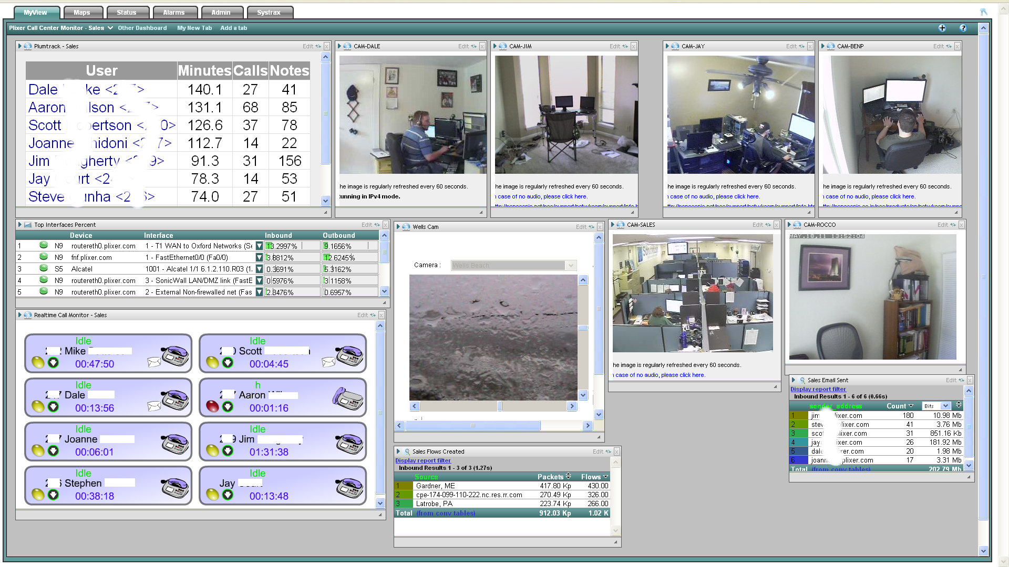
Remote Monitoring
Often on laptop, tablet and even Smartphone

Slide 14
Operations Monitoring
Network Operations
Monitoring all aspect of network systems
Business Operations
Monitoring business activities on network
Could be in the NOC or separate
Remote Monitoring
Technically all monitoring is remote
Can be your in-house Data center
Colocation site
Cloud monitoring
Can be, or supplement, Network & Business Monitoring

Slide 15
Fin…

